Slide 1
Women Internet Leaders
Monique Jeanne Morrow
March 8 2013
Distinguished Engineer
mmorrow@cisco.com
Notes:
Slide 1: [TITLE SLIDE]
A big Hello and Thanks to all of you … in Bangalore , Boxborough, Oslo … every corner of the world … here in San Jose, for joining first-ever Engineering Manager Town Hall.
Time of significant transition – in the market, the company and in Engineering. Important to stay in touch with what’s happening , with our teams and with each other.
Our employees recently voiced their feedback in the Pulse survey. Results showed: notable improvements in Recognition, Development and the Manager Index. Thank you for your contributions! But we also saw significant decreases in Org Alignment, Innovation, and Engagement.
Now more than ever, our success depends on all of us, as members of the Engineering Leadership team, to connect the work our teams do everyday to company and Engineering Priorities.
The opportunities before us are exciting, and there is no limit what we can do when Engineering executes as a united team. Most importantly we know this team can do it because you’re the best of the best - and we’re honored to be your leaders on this journey .
Today, we begin what will become an ongoing conversation with you about our Engineering direction, key priorities, and how you can help align your teams to deliver great results.
Tomorrow, we’ll come together again to expand the dialogue to all employees in our first Engineering Town Hall.

Slide 2

Agenda
History
Internet Hall of Fame Inductees
Donna Metzlar
Monique’s View
Summary

Slide 3
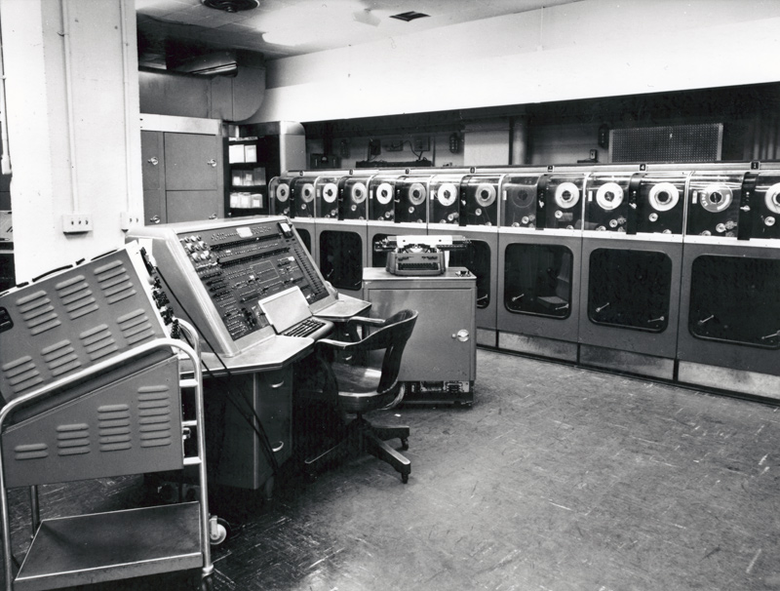
Front & Center:
Women in Technology
Notes:
http://womenshistory.about.com/

Slide 4
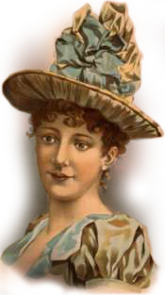


Front & Center: Mary Dixon Kies
First woman to be issued a U.S. patent, for a process of weaving straw with silk or thread for hats
Notes:
On May 15 1809, Mary Dixon Kies received the first U. S. patent issued to a woman. Kies, a Connecticut native, invented a process for weaving straw with silk or thread.

Slide 5
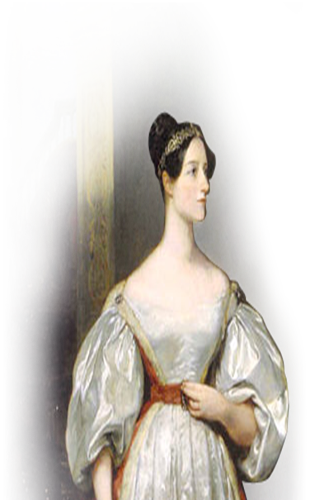
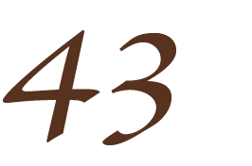
Front & Center: Ada Lovelace
Wrote the specifications for Babbage’s Analytical Engine (world’s first general purpose computer) and was
credited as the first-ever
computer programmer
Notes:
Ada Lovelace met Charles Babbage in 1833, and became interested in a model he had constructed of a mechanical device to compute values of quadratic functions, the Difference Engine. She also studied his ideas on another machine, the Analytical Engine, which would use punched cards to "read" instructions and data for solving mathematical problems.
Lovelace was asked to translate this article into English for a British scientific journal. She added many notes of her own to the translation, since she was familiar with Babbage's work. Her additions showed how Babbage's Analytical Engine would work, and gave a set of instructions for using the Engine for calculating Bernoulli numbers. She published the translation and notes under the initials "A.A.L," concealing her identity as did many women who published before women were more accepted as intellectual equals.
The engine was now recognized as a model for a computer, and Ada Lovelace's notes as a description of a computer and software.

Slide 6
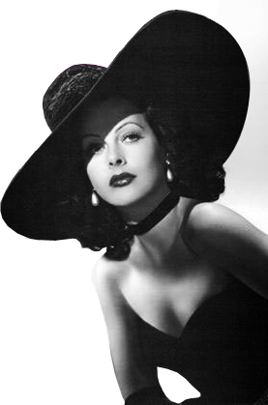
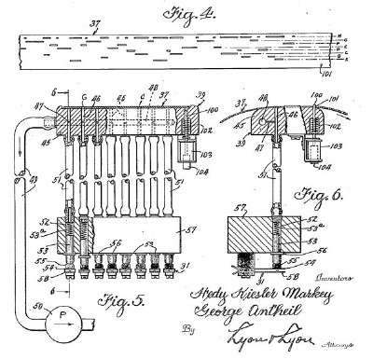

Front & Center: Hedy Lamarr
Silver screen movie star co-invented with George Antheil a radio communication system that created unbreakable code, used by the allies in WWII
Notes:
1941 Hedy Lamarr silver screen movie star co-invented with George Antheil a secret communication system that manipulated radio frequencies between transmission and reception to create an unbreakable code to prevent top-secret messages from being intercepted. The allies used it to defeat the Germans in WWII

Slide 7
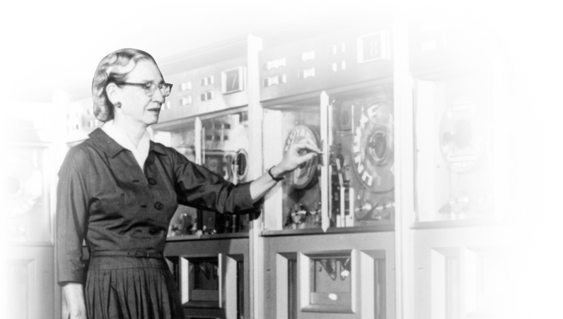

Front & Center: Grace Hopper
Inventor of the compiler which is the foundation of the COBOL computer language still used today
Notes:
Perhaps her best-known contribution to computing was the invention of the compiler, the intermediate program that translates English language instructions into the language of the target computer. She did this, she said, because she was lazy and hoped that "the programmer may return to being a mathematician."
Her work foreshadowed enormous numbers of developments that are now the foundations of digital computing: subroutines, formula translation, relative addressing, the linking loader, code optimization, and even symbolic manipulation of the kind embodied in Mathematica and Maple
In 1949 Hopper joined the Eckert-Mauchly Computer Corporation as a Senior Mathematician and there she worked with John Eckert and John Mauchly on the UNIVAC computer. She designed an improved compiler while working for the company and was part of the team which developed Flow-Matic, the first English-language data-processing compiler
Since Flow-Matic was the only existing business language at that time, it was inevitable that it should provide the foundations for the specification of the language COBOL (COmmon Business-Oriented Language) which eventually came out in 1959
http://www-groups.dcs.st-and.ac.uk/~history/Biographies/Hopper.html

Slide 8
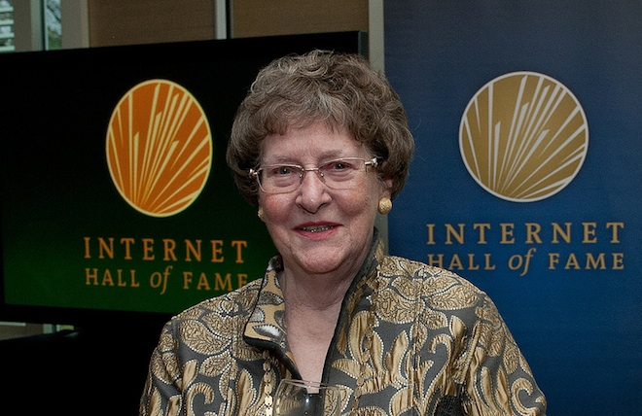
Internet Pioneer: Elizabeth Feinler
Elizabeth Feinler pioneered and managed first the ARPANET, and then the Defense Data Network (DDN), network information centers (NIC) under contract to the Department of Defense (DoD).
Both of these early networks were the forerunners of today’s Internet.

Slide 9
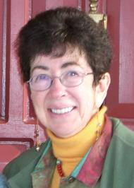
Global Connector: Nancy Hafkin
Among the first to enter the field of electronic communications in Africa, Nancy Hafkin has been a pioneer and innovator in the area of networking, development information, and electronic communications, working primarily with the UN Economic Commission for Africa (UNECA) in Addis Ababa.

Slide 10
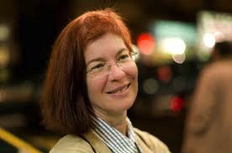
Innovator: Mitchell Baker
As an instrumental player in the development of the Mozilla project and as founding chairperson of the Mozilla Foundation, Baker helped legitimize Open Source Internet applications.

Slide 11
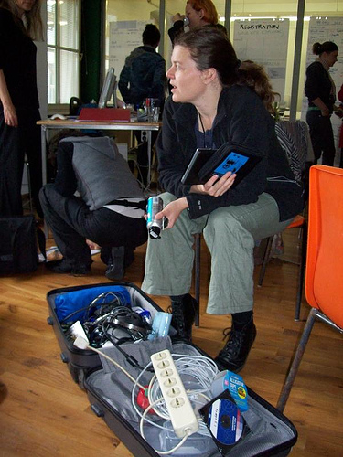
And Donna Metzlar: Women in Tech Freedom
The one aspect which remains constant is her commitment to social change.
Over the past 7 years she has actively been involved in the Genderchangers, a community of women enamoured with technology, especially free software, open source hardware and the universal interoperability of systems.
She takes a lead role in the annual event the Eclectic Tech Carnival (/ETC) and the Systerserver.
Her skills in ICT are self-taught.

Slide 12

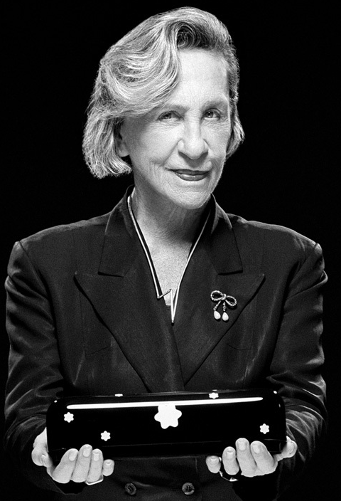
Towards Effecting Impact
I have no recipe for how to combine things. But you must be sincere. And if you are, strangely, it will succeed.
– Andree Putman
Notes:
Let me leave you with this …

Slide 13
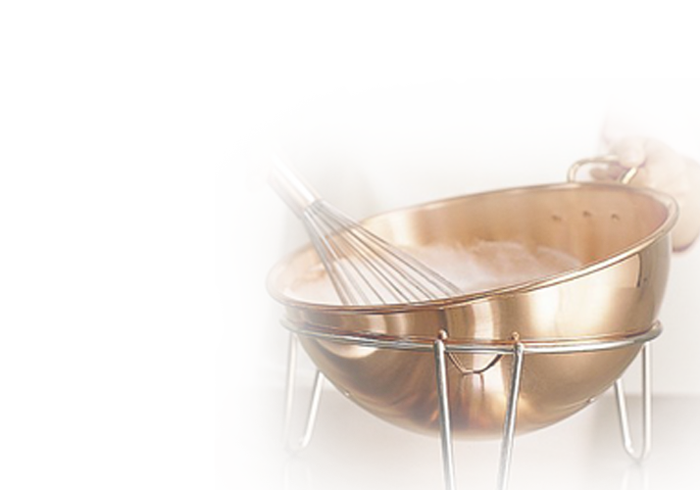
Ingredients
Passion
Expectations
Mindset
Risk
Notes:
There is no right or wrong approach
It starts with an idea, “What if?”
Use: “Help me to understand as lead in question for clarity
Not a fixed process, rather organic
Must take risk : Brian’s Dickinson’s Quest to Climb Mount Everest: http://blogs.cisco.com/collaboration/webex-talks-with-climber-at-mt-everest-base-camp/
Set expectations with yourself (picture)
Success is a mindset (picture)

Slide 14

Changing Role of Women in Technology
Pioneer
Influencer
Trail Blazer
Community Builder
Be Different
Be Yourself
Solo
Collaborate
Instruct
Share Experiences

Slide 15
Speaking from Experience
Leadership
The easiest way to get recognition
is to give it away
Lead laterally,
blur the boundaries
Break the mold to shape
the opportunity

Slide 16
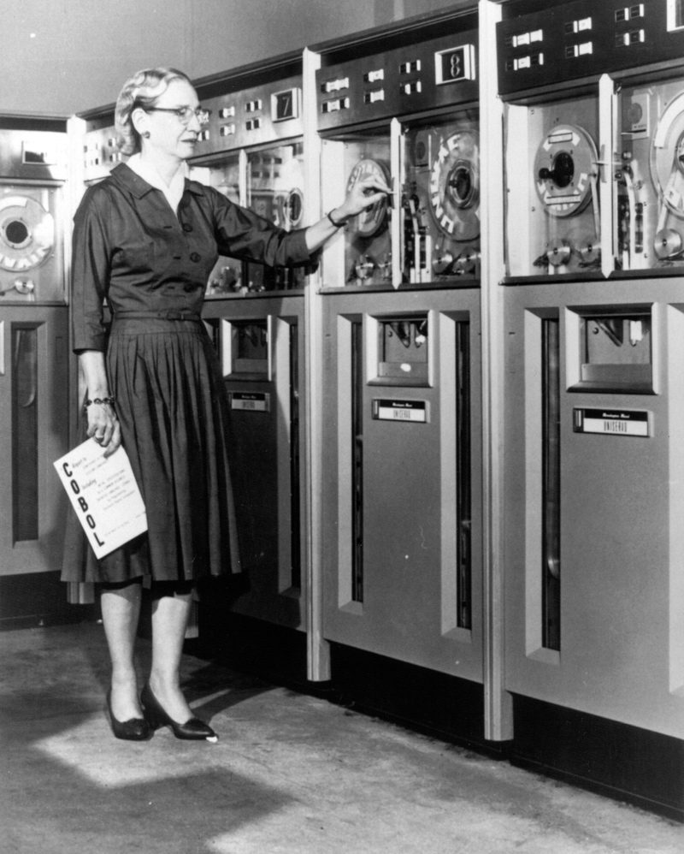
Words to Live By
It is easier to ask for forgiveness than it is to get permission.
– Grace Hopper
Notes:
Let me leave you with this …

